Slide 1

STUDENT INFORMATION CHATBOT
GUIDE –Dr.D.Sudha ,M.E.,Ph.D.
Associate Professor
BATCH-15
DHANUSHPRIYA.T – 211419104059
JECINTHA.T - 211419104112

Slide 2
INTRODUCTION
A chatbot is a computer software program that conducts a conversation via auditory or textual methods. Chatbots are programs that work on Artificial Intelligence (AI) & Machine Learning Platform.

Slide 3
Literature survey
YEAR | AUTHOR | TITLE | MERITS | DEMERITS
2018 | Mohammad Nuruzzaman, Omar Khadeer Hussain | A Survey on Chatbot Implementation in Customer Service Industry through Deep Neural Networks
LINK- https://www.computer.org/csdl/proceedings-article/icebe/2018/799200a054/17D45XzbnL3

Slide 4
Literature survey
YEAR | AUTHOR | TITLE | MERITS | DEMERITS
2021 | Gwendal Daniel, Jordi Cabot | The Software Challenges of Building Smart Chatbots.
LINK- https://ieeexplore.ieee.org/document/9402515/authors#authors

Slide 5
Literature survey
YEAR | AUTHOR | TITLE | MERITS | DEMERITS
2019 | Abhishek Singh, Karthik Ramasubramanian, Shrey Shivam | Building an Enterprise Chatbot
LINK-https://link.springer.com/book/10.1007/978-1-4842-5034-1

Slide 6
PROBLEM STATEMENT
Artificial intelligence chatbot is a technology that makes interactions between man and machines using natural language possible.
From literature, we found out that in general, chatbot are functions like a typical search engine. Although chatbot just produced only one output instead of multiple outputs/results, the basic process flow is the same where each time an input is entered, the new search will be done.
Nothing related to previous output. This research is focused on enabling chatbot to become a search engine that can process the next search with the relation to the previous search output.
In chatbot context, this functionality will enhance the capability of chatbot’s input processing.

Slide 7
DEVELOPMENT ENVIRONMENT
SOFTWARE COMPONENTS:
Windows 7 or higher
MySql
Wamp Server
HARDWARE COMPONENTS:
Processor – i3
Hard Disk – 5 GB
Memory – 1GB RAM

Slide 8
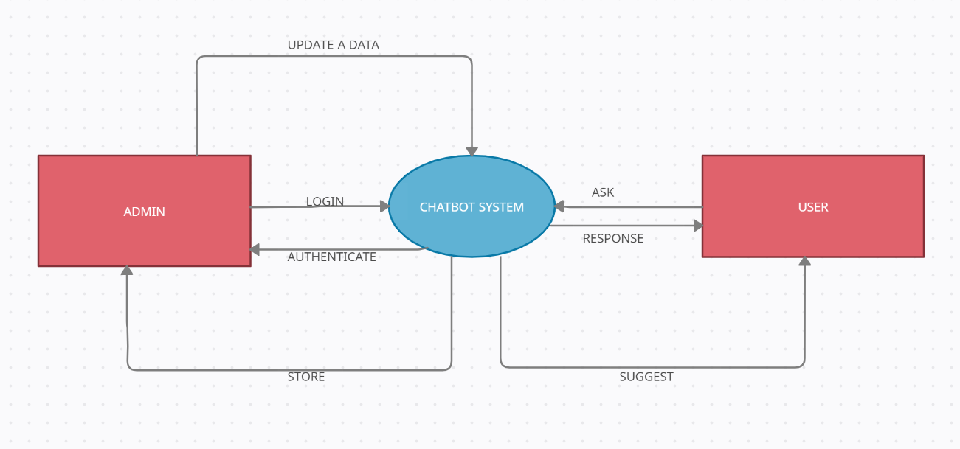
BASIC ARCHITECTURE

Slide 9
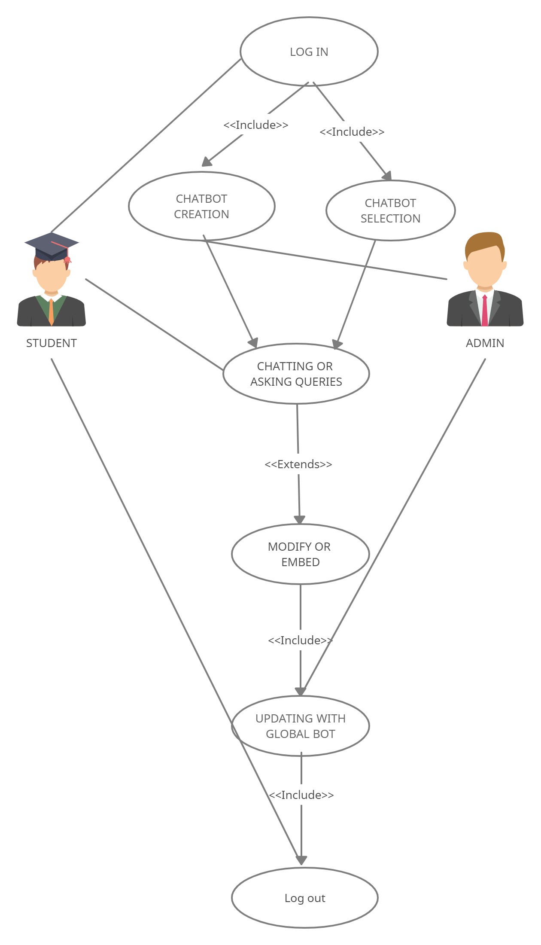
USECASE DIAGRAM

Slide 10
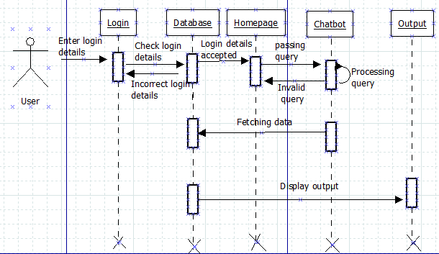
SEQUENCE DIAGRAM

Slide 11
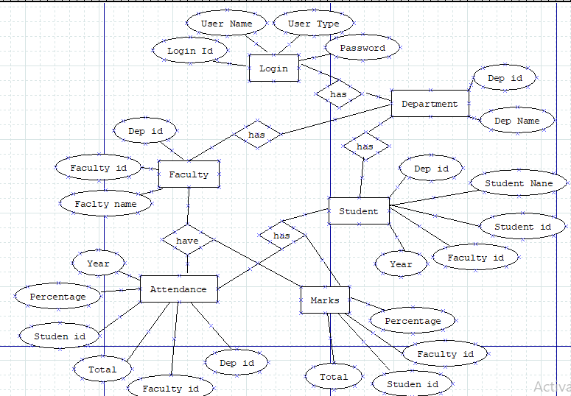
ER DIAGRAM

Slide 12
MODULES
Data Collection and Loading
Creating User modules
Assigning Permissions
Implementing Chatbot
Web Application

Slide 13
MODULES DESCRIPTION
Data Collection and Loading
The Students details from 2nd year to 4th year are collected and loaded into the database.
Creating User Modules
The different modules of this chatbot system are student, faculty, HOD, clerk, admin, attendance, marks, profile, graphs, chatbot.

Slide 14
MODULES DESCRIPTION
Providing permissions
The access permissions are provided to different users based on their roles.
Implementing chatbot
The chatbot is developed in python keeping in view of its users for more flexibility.
It receives the queries from the user processes it and fetches the data from the database.
Web application
It is designed using html for the user interaction with the bot at front end.

Slide 15
PROPOSED SYSTEM
The chat bot system introduces the areas where the people will interact and get solutions. Having the environment that one paves a path to chat bot system users. That path may be based on querying and answering. Introduced chat bot system will provide an interface that depends on text. This allows the users to type the commands and receive the text. It also involves receiving end may be having response as text to the speech.

Slide 16
ADVANTAGES
User does not have to go personally to college office for the enquiry.
This application enables the students to be updated with college cultural activities.
This application saves time for the student as well as teaching and non teaching staffs.

Slide 17
DISADVANTAGE
It requires active internet connection else error may occur.
Chatbots have limited responses, so they're not often able to answer multi-part questions or questions that require decisions. This often means your students are left without a solution, and have to go through more steps to contact your support team.

Slide 18
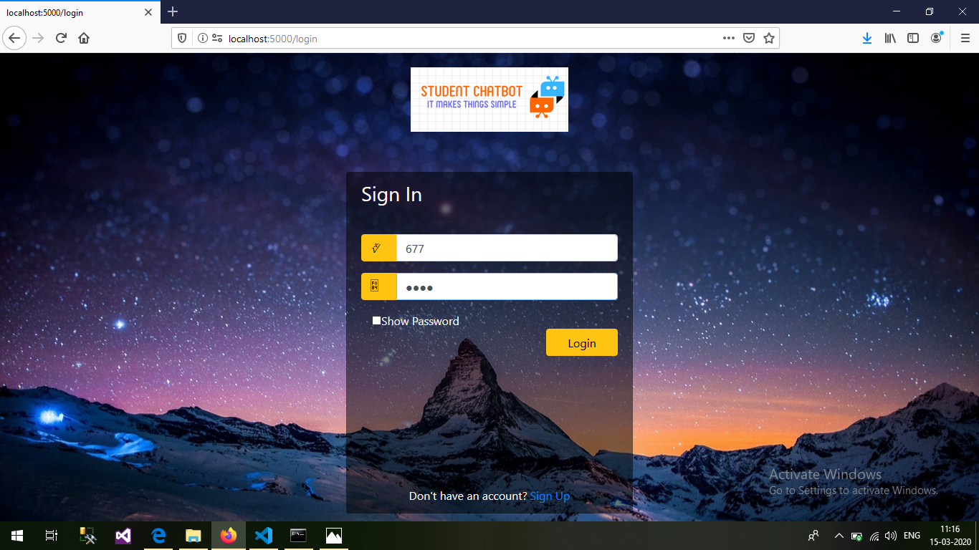
Login page

Slide 19
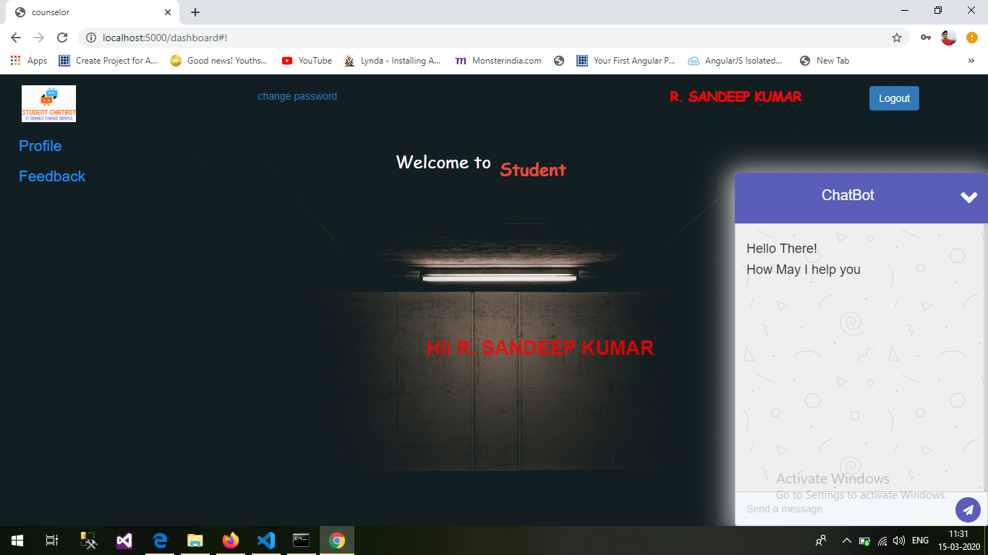
Chatbot

Slide 20
CONCLUSION
All this difficulties can be minimised, computation time and effort are reduced by automating the entire process by using student informative Chatbot.

Slide 21
THANKYOU

